Slide 1
AIM – HBO-ICT
Software
Design
Principles & PATTERNS: Strategy & OCP

Slide 2
Patterns are, simply, something that repeats itself in a predictable manner.
Our brains are terrific at identifying patterns. Not only that, they are good at predicting what those patterns imply, by using inductive thinking.
What are patterns
https://betterprogramming.pub/how-solid-remains-solid-software-principles-vs-patterns-c77c623a628b

Slide 3
Patterns in everyday life
Examples of Patterns can also be found in every area of life:
In the fashion industry, we have patterns as templates.
In nature, we have visual patterns of symmetry, fractals, and more.
In Software Engineering, we have design patterns.
Patterns build upon principles, so we first need to learn some principles to be able to learn patterns. In fact, principles build upon so called design properties (https://softengbook.org/chapter5)

Slide 4
Design patterns
Design principles
Design properties

Slide 5
Design patterns are typical solutions to commonly occurring problems in software design. They are like pre-made blueprints that you can customize to solve a recurring design problem in your code.
Design patterns

Slide 6
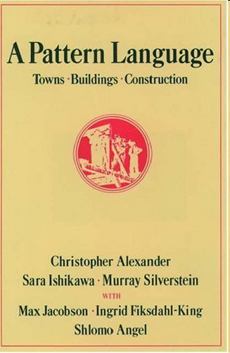

Once upon a time... 1977
https://refactoring.guru/design-patterns/history

Slide 7
Een Pattern definitie
“Elk patroon beschrijft een probleem dat zich steeds opnieuw voordoet in onze omgeving, en beschrijft vervolgens de kern van de oplossing voor dat probleem, op zo'n manier dat je deze oplossing een miljoen keer kunt gebruiken, zonder het ooit tweemaal op dezelfde manier te doen.”
(Alexander et al. 1977)

Slide 8
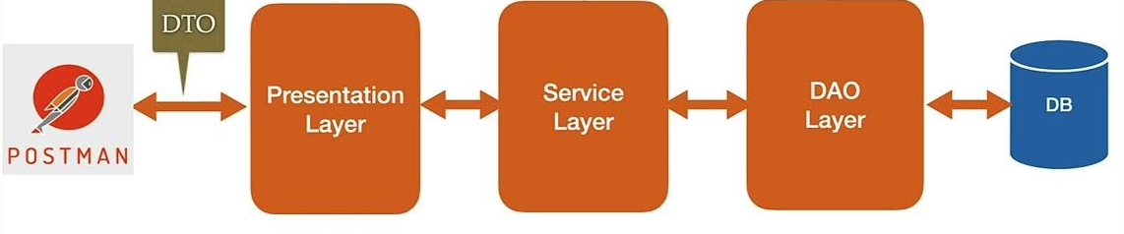
Patterns in eerder onderwijs
Data Transfer Object:
Conversie van data van ene vorm naar andere vorm of met andere inhoud
Layer:
Mogelijkheid om een laag te vervangen door een andere implementatie.
Communicatie van laag naar volgende laag, nooit eentje overslaan
Service Layer:
Scheiden van de API-functionaliteit en de (business) logica zoals algoritmes, rekenregels, validatie, etc.
Data Access Object:
Encapsuleren van toegang tot de database.
Beter bekend als Repository

Slide 9
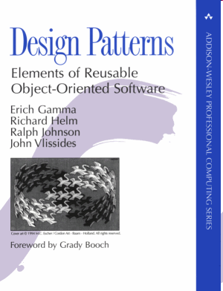
Template used for Design Patterns
Collected in catalogues
  Name
  Intent
  Also Known As
  Motivation (Context+Problem)
  Applicability (Context)
  Structure
  Participants
  Collaboration
  Consequences
  Implementation
  Sample Code
  Known Uses
  Related Patterns
All bold parts are used in our reference guide: https://refactoring.guru/design-patterns

Slide 10
Classification of patterns
Behavioural patterns take care of effective communication and the assignment of responsibilities between objects.
Structural patterns explain how to assemble objects and classes into larger structures, while keeping these structures flexible and efficient.
Creational patterns provide object creation mechanisms that increase flexibility and reuse of existing code.

Slide 11
Behavioural
Strategy

Slide 12
Strategy - INTENT
Demo
Problem
  How can we easily change the strategy of the algorithm?
  How can we easily add new strategies?
Solution
  For every strategy create a separate class that implements a shared interface
Intent
  Define a family of algorithms, put each of them into a separate class, and make their objects interchangeable.

Slide 13
Strategy – applicability
Use the Strategy pattern when you want to use different variants of an algorithm within an object and be able to switch from one algorithm to another during runtime.
Use the Strategy when you have a lot of similar classes that only differ in the way they execute some behaviour.
Use the pattern to isolate the business logic of a class from the implementation details of algorithms that may not be as important in the context of that logic.
Use the pattern when your class has a massive conditional statement that switches between different variants of the same algorithm.

Slide 14
Strategy – pros and cons
Pro
Con
You can swap algorithms used inside an object at runtime.
You can isolate the implementation details of an algorithm from the code that uses it.
You can replace inheritance with composition.
Open/Closed Principle. You can introduce new strategies without having to change the context.
If you only have a couple of algorithms and they rarely change, there’s no real reason to overcomplicate the program with new classes and interfaces that come along with the pattern.
Clients must be aware of the differences between strategies to be able to select a proper one.
A lot of modern programming languages have functional type support that lets you implement different versions of an algorithm inside a set of anonymous functions. Then you could use these functions exactly as you’d have used the strategy objects, but without bloating your code with extra classes and interfaces.

Slide 15
Open/Closed Principle
Software-entiteiten moeten open zijn voor uitbreiding, maar gesloten voor aanpassing.
Opdracht:
  Individueel:
    Vraag een GenAI naar een uitleg van dit principe en lees dit
    Vraag vervolgens om een codevoorbeeld in Java
  In tweetallen: vergelijk de codevoorbeelden
  Klassikaal: benoem de verschillen en overeenkomsten.

Slide 16
Principles are fundamental truths.
They serve as the foundation upon which one can build more complex systems and theories.
When it comes to creating new things, principles are crucial.
They allow us to achieve … results, by connecting the dots in new and previously unthought-of ways.
What are PRINCIPLES
https://betterprogramming.pub/how-solid-remains-solid-software-principles-vs-patterns-c77c623a628b

Slide 17
Principles in everyday life
Examples of principles can be found in every area of life:
In Psychology, we have the pleasure principle.
In Physics, we have the principles of motion.
In Software Engineering, we have the SOLID design principles.
“The instinctive seeking of pleasure and avoiding of pain to satisfy biological and psychological needs.”
A body remains at rest, or in motion at a constant speed in a straight line, except insofar as it is acted upon by a force.
At any instant of time, the net force on a body is equal to the body's acceleration multiplied by its mass or, equivalently, the rate at which the body's momentum is changing with time.
If two bodies exert forces on each other, these forces have the same magnitude but opposite directions

Slide 18
Patterns are, simply, something that repeats itself in a predictable manner.
Our brains are terrific at identifying patterns. Not only that, they are good at predicting what those patterns imply, by using inductive thinking.
What are patterns
https://betterprogramming.pub/how-solid-remains-solid-software-principles-vs-patterns-c77c623a628b

Slide 19
Patterns in everyday life
Examples of Patterns can also be found in every area of life:
In the fashion industry, we have patterns as templates.
In nature, we have visual patterns of symmetry, fractals, and more.
In Software Engineering, we have design patterns.
Patterns build upon principles, so we first need to learn some principles to be able to learn patterns. In fact, principles build upon so called design properties (https://softengbook.org/chapter5)

Slide 20
Design patterns
Design principles
Design properties
Volgende les

